Slide 1
Piaget’s cognitive theory
Wanli Mao
Institute of Micro and Nano Science and Technology
Shanghai Jiao Tong University
2513195842@qq.com

Slide 2
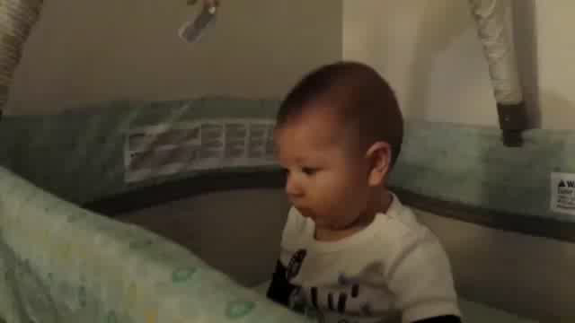
Hide and laugh
Peekaboo
  A popular game among infants

Slide 3

Hide and laugh
Peekaboo
What is behind the game
  It’s a funny game
  Infants find it to be strange

Slide 4

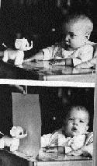
Out of sight, out of mind
Object permanence
    Existing without being observed
What a nice surprise!
Hide-and-seek
  A six-month-old
  A toy and a cover
Notes:
A not bad conjecture. We do laugh at magic,
The baby is surprised at your reappearing.
believe the appeal of the game is fooling the children into thinking they are invisible.

Slide 5
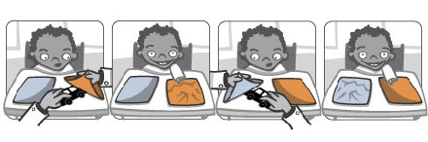
Out of sight, out of mind
Object permanence
    Existing without being observed
What a nice surprise!
Hide and seek
  A six-month-old
  A toy and a cover
A not B error
Notes:
A not bad conjecture. We do laugh at magic,
The baby is surprised at your reappearing.

Slide 6
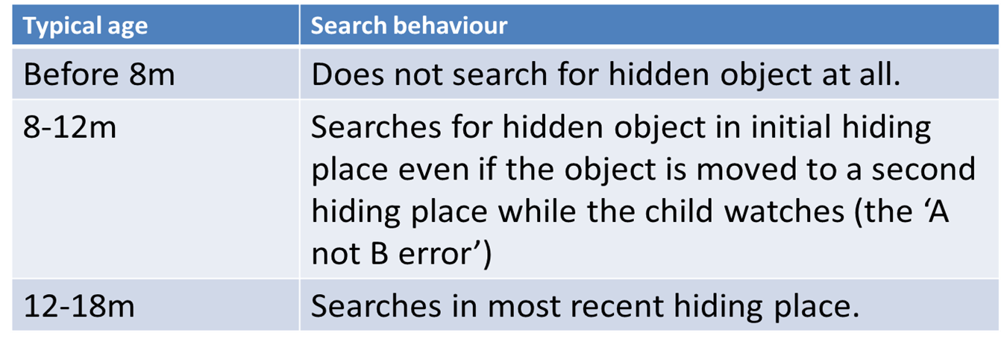
Stage theory
Notes:
And conclusions.
Firstly, they don’t search for hidden objects at all. Then, they commit A-not-B errors. Finally, they learn to search in most recent hiding place. And ‘out of sight, out of mind’ isn’t just an epigram after all.

Slide 7
Thank you !
Notes:
A not bad conjecture. We do laugh at magic,
The baby is surprised at your reappearing.

Slide 8
References:
  https://en.wikipedia.org/wiki/Object_permanence
  http://oyc.yale.edu/transcript/309/psyc-110
Notes:
A not bad conjecture. We do laugh at magic,
The baby is surprised at your reappearing.
believe the appeal of the game is fooling the children into thinking they are invisible.

